Slide 1
Chapter 3 Part 2

Slide 2
Key Systems As They Relate To Human Nutrition

Slide 3
Cardiovascular system
- Blood flows through the heart and blood vessels from pumping of the heart
- Blood is made up of plasma, red blood cells, white blood cells, platelets and other substances

Slide 4
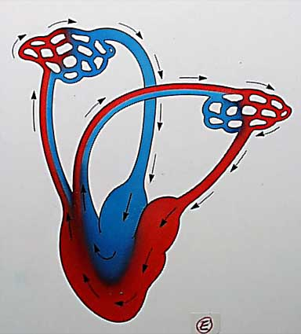
Cardiovascular system
Routes of travel:
a) Right side of heart, to lungs to pick up oxygen and drop carbon dioxide then travels back to the heart
b) Oxygenated blood travels through arteries from the left side of the heart out to the body (capillaries) then back to the heart through veins

Slide 5
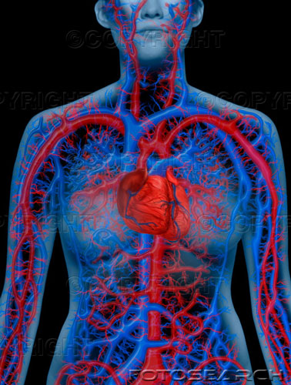
Cardiovascular system
Exchange of nutrients, oxygen and waste occurs in the tiny capillaries throughout the body

Slide 6
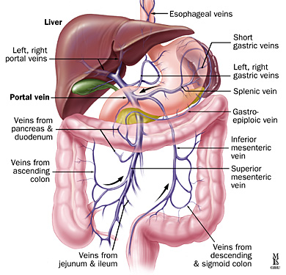
Cardiovascular system
Portal circulation in the gastrointestinal tract
- Capillaries in the intestines and stomach take up nutrients from recently eaten foods
- These capillaries merge into veins that empty into the portal vein
Portal vein leads to the liver
Liver processes the absorbed nutrients before they enter the general circulation

Slide 7
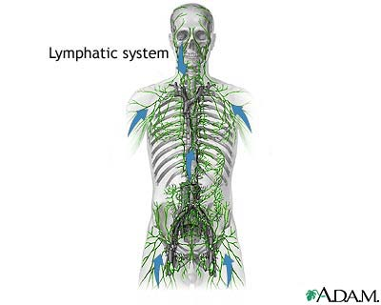
Lymphatic System
- Lymph flows through the lymphatic vessels and lymph tissues
- Lymph consist of plasma and white blood cells
- Lymph flows throughout the body and eventually empties in to major veins near the heart
- Flow is driven by muscle contractions from normal body movement

Slide 8
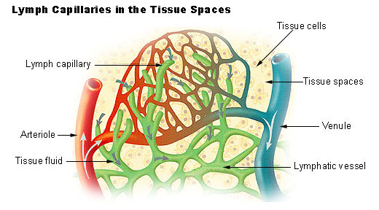
Lymphatic System
Lymphatic circulation in the gastrointestinal tract:
Lymph vessels pick up the majority of products yielded from fat absorption
These products are too large to enter the bloodstream directly

Slide 9
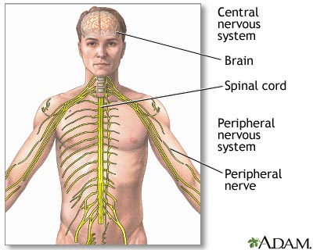
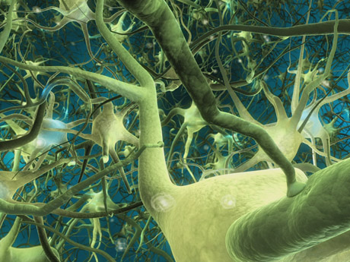
Nervous System
- Controls most body functions
- Basic structural and functional unit is the neuron
- Neurons respond to signals and impulses throughout the body by releasing chemical regulators
- Transmission of the signals utilizes potassium and sodium

Slide 10
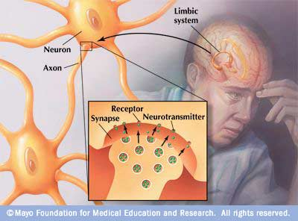
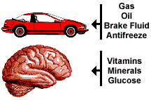
Nervous System
- Signals between neurons use neurotransmitters
- Neurotransmitters are made from nutrients like amino acids
Calcium is required for the release of neurotransmitters from the neurons.
B-12 is needed in formation of the myelin sheath which insulates most neurons
- Glucose is needed to fuel the brain

Slide 11
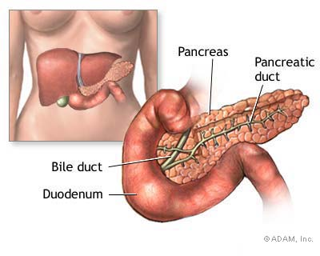
Endocrine (Hormonal) System
1) Insulin:
- Made in and released from the pancreas
- Helps control glucose by allowing it's movement from the blood to muscle and adipose cells
- In liver cells, insulin stimulates conversion from glucose to glycogen for storage

Slide 12
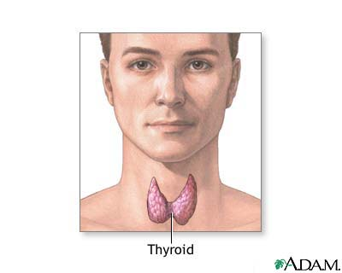
Endocrine (Hormonal) System
2) Epinephrine, norepinephrine, glucagon and growth hormone all increase blood glucose
3) Thyroid hormone:
- Regulates rate of metabolism

Slide 13
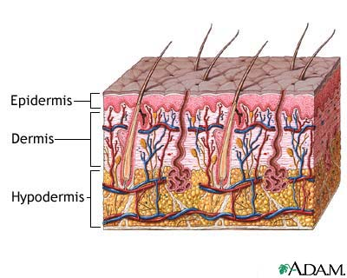
Immune System
1- Skin
- Barrier surrounding the body
- Has glands that secrete lysozyme
- Deficiencies of Vit A and zinc affect skins integrity

Slide 14
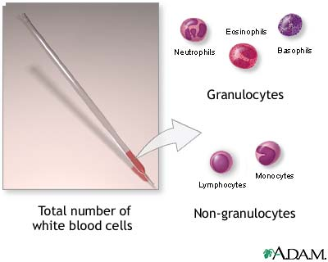
Immune System
2- White blood cells (WBC)
Attack microorganisms by phagocytosis,
Produce antibodies
- Are the immune system cells

Slide 15
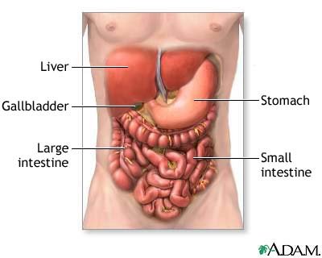
Digestive system
Food must be digested/ broken down to provide us with usable nutrients
1) Mechanical Digestion: e.g. chewing
2) Chemical Digestion: e.g enzymes secretion into the GI tract to breakdown food.

Slide 16
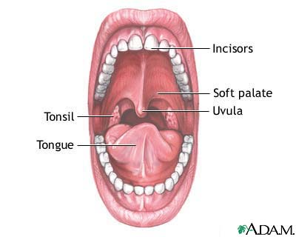
Digestive system
The Gastrointestinal tract is a tube that extends from the mouth to the anus and is composed of 6 organs
1) Mouth
Chewing. Tongue aids chewing
Taste receptors: sweet, salty, bitter, sour and savory (pungent)
Salivary glands produce saliva
1- Salivary amylase, starch digesting enzyme
2- Mucus, lubricates and makes swallowing easier

Slide 17
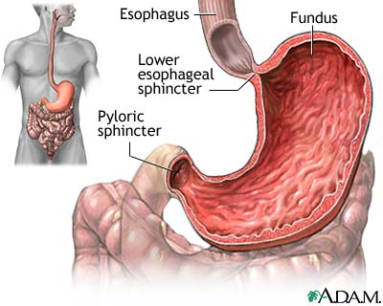
Stomach
- Secretes acid and enzymes to digest protein
- mixes and then holds food for one to four hours
- Produces chyme
- Very little nutrient absorption occurs
- Chyme leaves stomach regulated by the pyloric sphincter about 1 tsp at a time
- Produces intrinsic factor for B-12 absorption

Slide 18
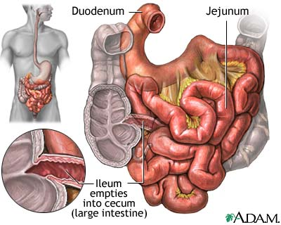
Small intestine
- About 10 feet long and 1" in diameter
- Chyme mixes with digestive juices to digest macronutrients and prepare vitamins and minerals for absorption
- Villi are folds that create large surface area and trap food to promote nutrient absorption

Slide 19
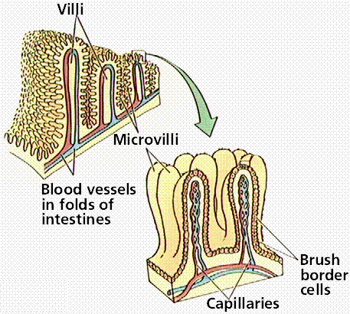
Small intestine
Absorption occurs by different processes
1] Passive absorption
2] Facilitated absorption
3] Active absorption
4] Phagocytosis and pinocytosis.
- Glucose and amino acids are absorbed into the capillaries and to the portal vein
- Most fats go into the lymph vessels

Slide 20
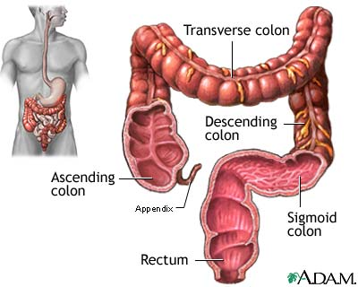
Large intestine
- 5% of unabsorbed carbohydrate, protein, and fat reach large intestines
- Some vitamins, water, fatty acids, sodium and potassium are absorbed
- No villi or digestive enzymes
- Mucus protects large intestines from bacterial infections
- Bacteria breakdown lactose and some fiber
- Feces formed

Slide 21
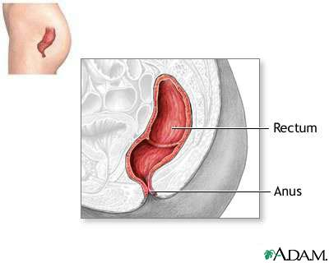
Rectum
- Two sphincters control elimination of waste
- External sphincter is voluntarily controlled

Slide 22
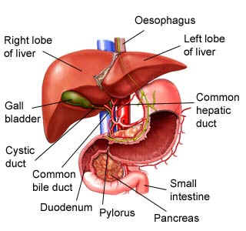
Accessory organs
Not part of GI tract but part of digestive system
a) Liver produces bile
b) Gallbladder stores bile
c) Pancreas provides enzymes and hormones:
Extra info: Pancreatic juice containing bicarbonate that neutralizes the acid from the stomach protecting the small intestines as chyme enters

Slide 23
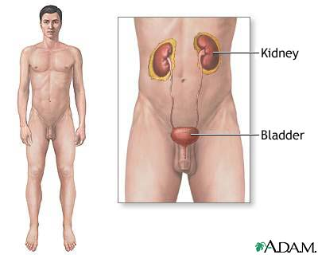
Urinary system
Two Kidneys remove wastes from the body
Kidneys help maintain acid-base balance of the blood
Kidneys convert Vit D to an active hormone
Kidneys produce glucose from amino acids during fasting
Excess water-soluble nutrients and minerals are filtered
Urea travels from kidneys to bladder by ureter
Bladder empties through urethra

Slide 24
Storage capabilities
- Adipose cells store fat
- Muscle and liver store carbohydrates as glycogen
- Blood contains a small reserve of amino acids and glucose
- Many vitamins and minerals are stored in the liver
- Calcium is taken from bones if needed
- Protein can be taken from muscles if needed

Slide 25
http://www.youtube.com/watch?v=pGENxQQvRZA&feature=related
http://www.youtube.com/watch?v=1vFbQjGEhcQ

