Slide 1
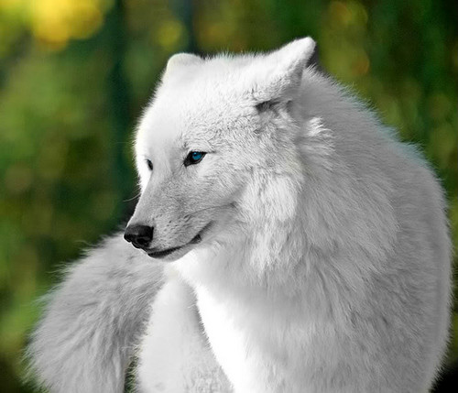
A View of Life
BIOL 1000: General Biology
Chapter 1
Dr. Mohamad H. Termos

Slide 2
How to Define Life?
All living things are comprised of the same chemical elements and obey the same physical and chemical laws as nonliving objects.
A cell is the smallest, most basic unit of life.
Tissue
Organs
Systems

Slide 3
Nine Characteristics of Life
All living organisms have same basic ingredients, DNA or RNA.
All living organisms have cells, which are the building blocks of life.
All need water and a source or energy (food and sugar).
Can reproduce and grow (they get larger and keep generation going).
Must die (end) at a certain point.
Can adapt to surroundings (adapt to danger and changes in the environment).
Can move to avoid harm or death.
Have the ability to heal injuries.
Can evolve.

Slide 4
List of the 7 Characteristics of Life
Cells - smallest unit capable of life functions (basic unit of life);
Organization;
Metabolism - the sum of all chemical reactions, metabolism refers to a living organism's ability to consume and use energy (from food or from the sun);
Homeostasis - maintaining stable internal conditions biological balance)
Heredity;
Responsiveness;
Growth

Slide 5
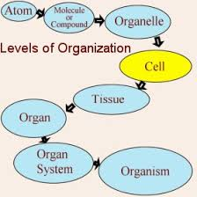
Living Things are Organized
1. Begins with The Cell
1. Smallest basic Unit
2. Composed of Non-Living Chemicals
2. Multi-cellular Organisms
1. Forms Tissues
2. Tissues Forms Organs
3. Organs Work Toward Systems
Emergent Properties:
– Each level of organization is more complex and has properties beyond the preceding level.
- Each new level of organization has emergent properties due to interactions between different parts of the whole.

Slide 6
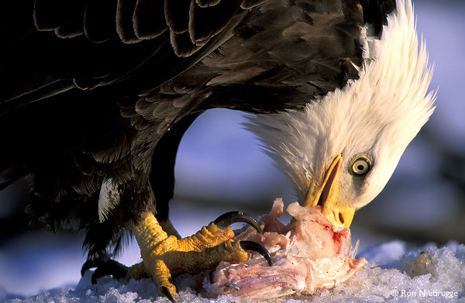
Materials and Energy
• Energy is the capacity to do work.
– Metabolism encompasses all the chemical reactions that occur in a cell.
- Homeostasis - Maintenance of internal conditions within certain boundaries.
– The sun is the ultimate source of energy for nearly all life on the planet.
- Photosynthesis

Slide 7
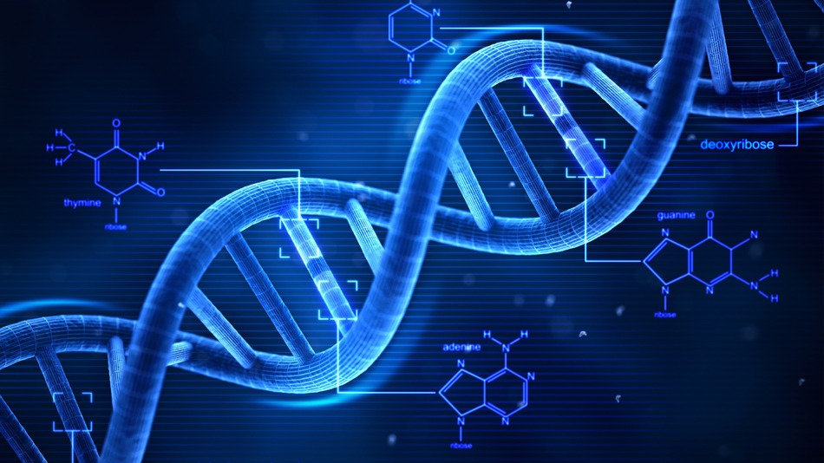
Reproduction and Development
• In most multicellular organisms, reproduction begins with the union of two gametes from different individuals.
– Organizational instructions encoded in genes.
- Composed of DNA

Slide 8
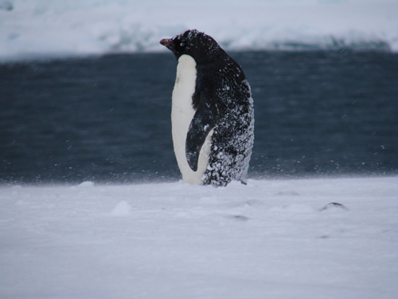
Adaptations
• Adaptation - Any modification that makes an organism suited to its way of life.
– Over time, organisms become modified by the process of natural selection.
- The unity of characteristics between different types of organisms suggests that all living things are descended from a common ancestor.
- Descent with modification
Notes:
Penguins have evolved complex behaviors, such as sliding across ice to conserve energy, to adapt to their environment.

Slide 9
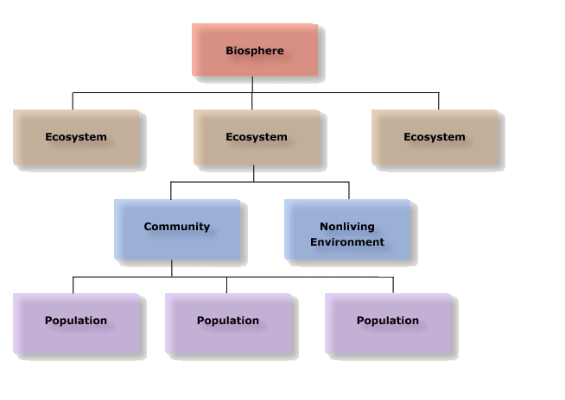
Biosphere Organization
• All members of a species within a particular area are known as a population.
– A collection of interacting populations is known as a community.
- A collection of communities make up an ecosystem.
- Ecosystems are characterized by chemical cycling and energy flow, both originating from photosynthesis.

Slide 10
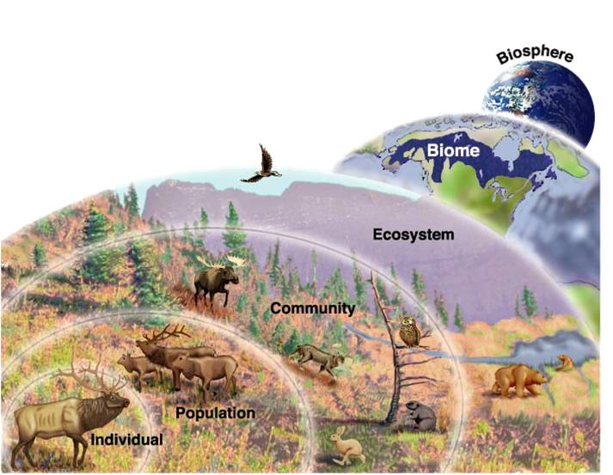
How is Biosphere Organized?
A. Bio-sphere – Air, land and water
B. Population – Species
C. Community – Populations that interact in the physical environment
A. Soil, Atmosphere, Etc.
D. Ecosystem
A. Chemical cycling and energy flow
B. Begins with photosynthesis

Slide 11
Biological Organization
A. Populations (i.e. owls, squirrels, etc.)
B. Communities (i.e. animals and forests)
C. Physical environment (i.e. soil,
temperature, air, land, and water )
D. Eco-system (i.e. communities plus
physical environment)
E. Bio-Sphere (i.e. population, community, physical environment, eco-system)

Slide 12
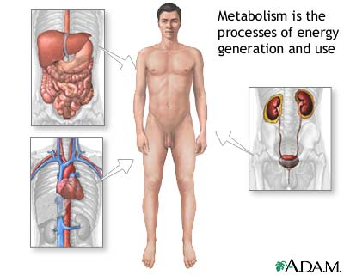
Energy and Metabolism
A. Living things need an outside source of energy and materials (Food)
B. Foods provide nutrients and energy
C. Food is the building blocks for energy
D. Energy – “Capacity to do work”
E. Metabolism –
A. All Chemicals reactions occur in the cell

Slide 13
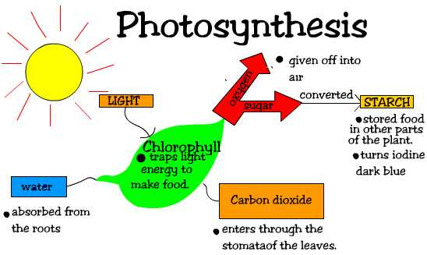
Energy
A. The sun is the ultimate source of the earths energy
B. Photosynthesis
a. transforms solar energy into chemical energy
b. animals and plants get energy by
photosynthesis
C. Homeostasis
a. stability in temperature, moisture levels, acidity, and physiological factors
D. Hormones to regulate sugar storage

Slide 14
Living Organisms and the Environment
Organisms respond to the environment through their senses: visual, hearing, smell, touch.
Plants respond by movement toward the sun (chemical survival).
Animals respond by being aware (survival, daily activities, behavior).
Reproduction and Development (Life Comes Only From Life).
Some organisms reproduce themselves
Unicellular organisms split in two (bacteria, protists).
Multicellular organisms (sperm, egg, stages to become an adult).
Genes – specific information on long molecules (DNA)

Slide 15
Adaptation and Natural Selection
Adaptations are modifications in response to certain conditions (such as cold or hot climates).
Natural selection: Changes in the genetic structure of populations due to differential survival and reproduction.
More are born than can survive and/or reproduce.
There is genetic variation for phenotypes (characteristics) that affect survival and/or reproduction.
Those individuals with phenotypes that are best suited to the environment will be most likely to survive and reproduce.
The next generation will have a higher percentage of the best-fit individuals and a lower percentage of less-fit individuals.

Slide 16
Natural Selection & Evolution
Evidence For Evolution by Natural Selection
1- Fossil Record (transitional forms like Basilosaurus—whale-like fossil with small hind legs, moveable knees, toes), 2- Biogeographic Distributions of Related Species, 3- Biochemical and Anatomical Similarities Among Related Species, 4- Patterns of Genetic Relatedness (for example, predicted fusion of chimp chromosomes in the human genome)
Evolution is the change in groups of organisms over the course of generations. The changes in populations that are considered evolutionary are those that are passed via the genetic material from one generation to the next (Futuyma, 2009)
Futuyma, Douglas J. (2009). Evolution. Siauer Associates Inc., Sunderland, MA

Slide 17
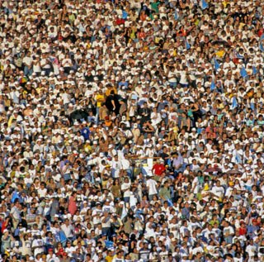
Human Population
The human population tends to modify existing ecosystems for its own purpose.
Human beings depend on healthy ecosystems for food, medicines, other raw materials, as well as the benefits of various ecosystem processes.

Slide 18
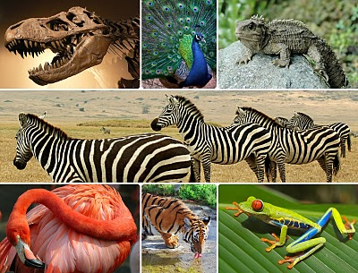
Biodiversity
Biodiversity is the total number of species, the variability of their genes, and the ecosystems in which they live.
– Extinction is the death of a species or larger taxonomic group.
How do we (humans) modify ecosystem?
Construction of roads and buildings (surface soil removed, kill soil organisms, change in shape and slope of land → resulting in different patterns of drainage of rainwater, farmland taken by roads can no longer used to grow crops and livestock).

Slide 19
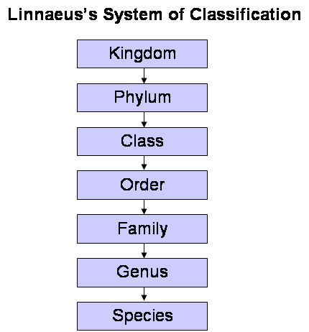
Classification of Living Organisms
Taxonomy is the discipline of identifying and classifying organisms.
– From least inclusive to most inclusive: Species, genus, family, order, class, phylum, kingdom, and domain.
- Each successive category above species contains more distinct types of organisms than the preceding category.

Slide 20
Classification
A. Taxonomy
a. identifying and classifying organisms
B. Categories of Classification
a. from larger to smaller
b. kingdom, phylum, class, order, family, genus and
species
C. Domains
a. three domains
a. Bacteria (unicellular prokaryotes)
b. archaea - live in water, cannot tolerate oxygen and survive in harsh temperatures, salts and acids (unicellular prokaryotes).
c. eukarya - membrane-bounded nucleus (eukaryotes).
D. Kingdoms
a. protisa, fungi, plantae and animals

Slide 21
Process of Science
• Observation: Any phenomenon can be more fully understood by observation.
• Hypothesis: Use of inductive reasoning to form an explanation for the observed phenomenon.
• Experiments: Use of inductive reasoning to form an appropriate experimental design (control group, model).
• Data: Observable, objective results of an experiment. The greater the variance in the data, the greater the probability of error.
. Conclusion: Data must be analyzed in order to reach a conclusion as to whether or not the hypothesis is supported.
– Findings must be reported in scientific journals so methodology and data are open for inspection and repetition.

Slide 22
Description of the Emergent Properties of Life
1. Order. Organisms are highly ordered, and other characteristics of life emerge from this complex organization. 2. Reproduction. Organisms reproduce; life comes only from life (biogenesis). 3. Growth and Development. Heritable programs stored in DNA direct the species-specific pattern of growth and development. 4. Energy Utilization. Organisms take in and transform energy to do work, including the maintenance of their ordered state. 5. Response to Environment. Organisms respond to stimuli from their environment. 6. Homeostasis. Organisms regulate their internal environment to maintain a steady-state, even in the face of a fluctuating external environment. 7. Evolutionary Adaptation. Life evolves in response to interactions between organisms and their environment.

Slide 23
The Process of Science
A. Scientific Method
A. Observation
B. Hypothesis
C. Experiments/Further Observations
D. Data/Results
E. Conclusion
B. Biology is the scientific study of Life
Scientific Theory: Joins together two or more related hypotheses.
– Supported by a broad range of observations, experiments, and data.
• Scientific Principle / Law: Theory, or set of theories, generally accepted by an overwhelming number of scientists.
Scientific theory: Supported by a broad range of observations, experiments and data
Some basic biology theories: Cell Theory, Biogenesis, Gene, Evolution.

